Slide 1
UAS Alert
Final Design Presentation

Slide 2
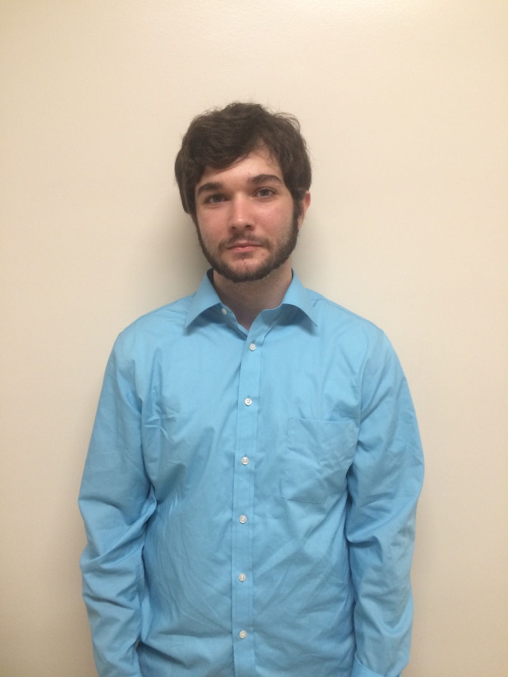

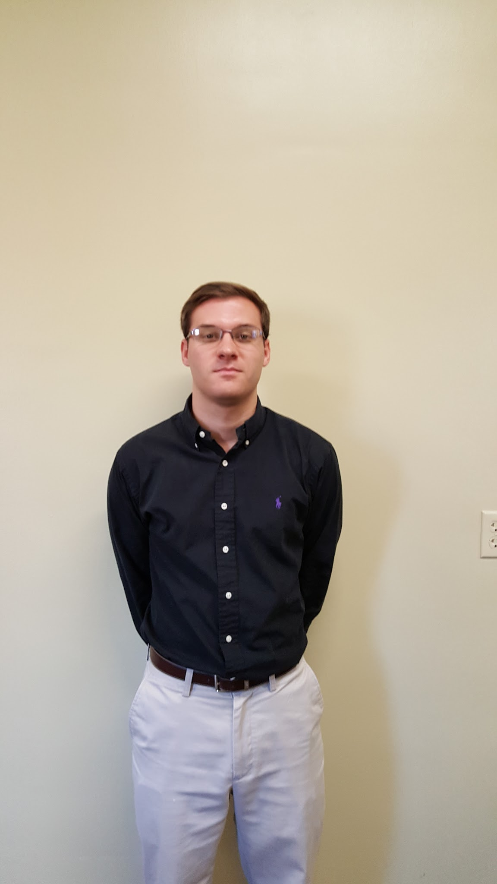


Team Members
Brian Joyner
Carter Long
Clayton Hudspeth
Brady Wade
Chase Abercrombie
Computer Engineering
Electrical Engineering
Electrical Engineering
Electrical Engineering
Electrical Engineering
Notes:
wbw

Slide 3

Advisor
Dr. J.W. Bruce
Associate Professor
Mississippi State University
Ph.D., Electrical Engineering, University of Nevada Las Vegas, 2000
M.S., Electrical Engineering, Georgia Institute of Technology, 1993
B.S., Electrical Engineering, The University of Alabama in Huntsville, 1991
Notes:
wbw

Slide 4
Teaming
 | Website | Power Supply Design | Compact Design Lead | Communications/ Display Software | Documentation Lead
Brian Joyner | ✔ |  |  | ✔
Clayton Hudspeth | ✔ |  |  | ✔
Brady Wade |  | ✔ |  |  | ✔
Chase Abercrombie |  | ✔ | ✔
Carter Long |  | ✔ |  |  | ✔
Notes:
wbw

Slide 5
Agenda
Problem and Solution
System Overview
Constraints
Practical
Technical
System Testing
Timeline
Progress
Future Work
Questions

Slide 6
Problem & Solution
Notes:
wbw

Slide 7
Problem Statement
During a nine month period, November 2014 to August 2015, the FAA reported 764 UAV sightings where the UAV compromised the safety of the aircraft [1].
UAS operators do not have to go through any safety training or certification before being allowed to operate a UAV.
Recent FAA rules allow for a UAV to fly above 400 ft. through a waiver application.
Notes:
wbw

Slide 8
Solution
Provide UAVs the ability to map and track nearby air traffic.
Create a device that can be easily attached to any UAV.
Give alerts to help mitigate the chance of mid air collisions.
Notes:
wbw

Slide 9
System Overview
Notes:
wbw

Slide 10
Constraints
Notes:
acl

Slide 11
Practical Constraints
Safety
Real time mapping
Accurate Results
Alerts to keep pilots safe
Political
Can only use ADS-B IN
Cannot broadcast on unauthorized frequencies
Notes:
acl

Slide 12
Technical Constraints
Constraint | Description
Transmission | Line-of-sight range on 900MHz and must have longer range than UAV controller
Device Weight | The on board device must weigh less than 300 g
Battery Life | The battery must last longer than 1 hr
Compact Design | The device must have at max these dimensions 150x150x100 mm
Response Time | UAS’s response time must be less than 1 min
Notes:
acl

Slide 13
System Testing

Slide 14
System Testing
Signal Strength and range of transceivers
Device Weight
Battery Life
Forwarding of Data
Notes:
clayton

Slide 15
Transceiver Signal Testing
Tested at multiple distances
Minimal obstruction
Test was done with packet size of 50 bytes
100 packets were sent and received in 2 minutes
Tested transmission range up to 1200 ft. Our constraints requires 3280 ft.
Notes:
clayton

Slide 16
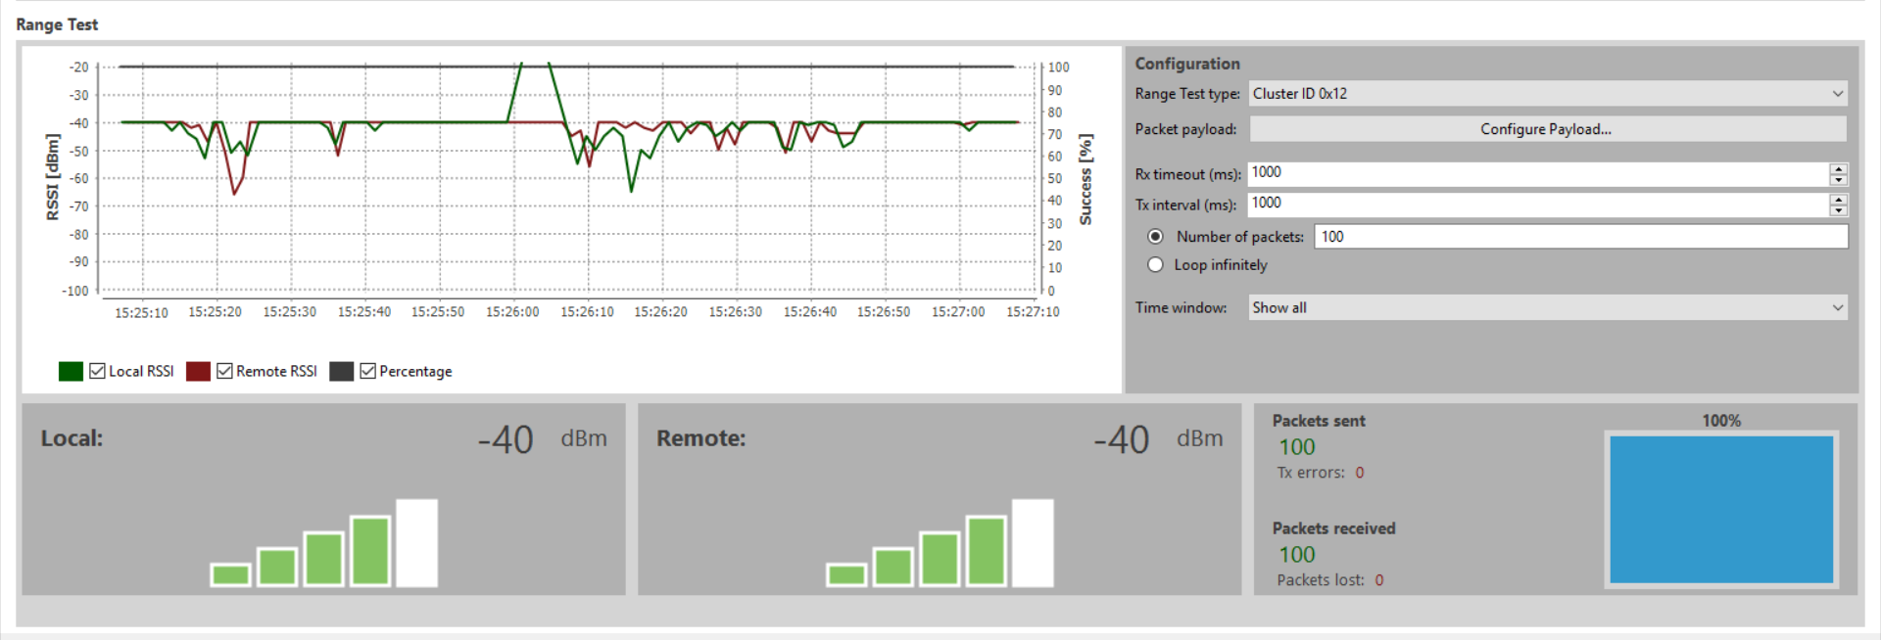
Transceiver Signal Test at 280 ft.
Notes:
clayton

Slide 17
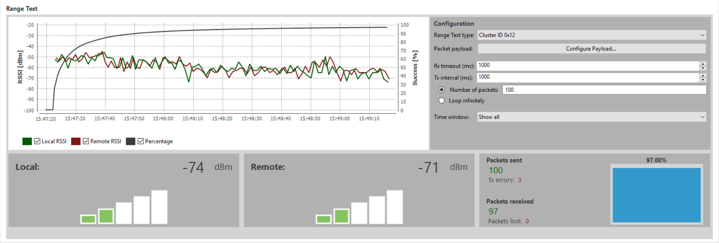
Transceiver Signal Test at 520 ft.
Notes:
clayton

Slide 18
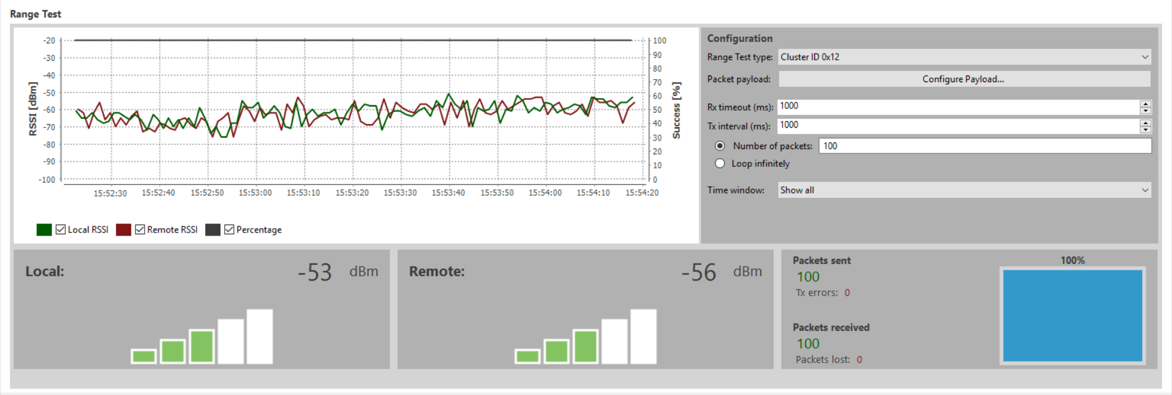
Transceiver Signal Test at 1200 ft.
Notes:
clayton

Slide 19
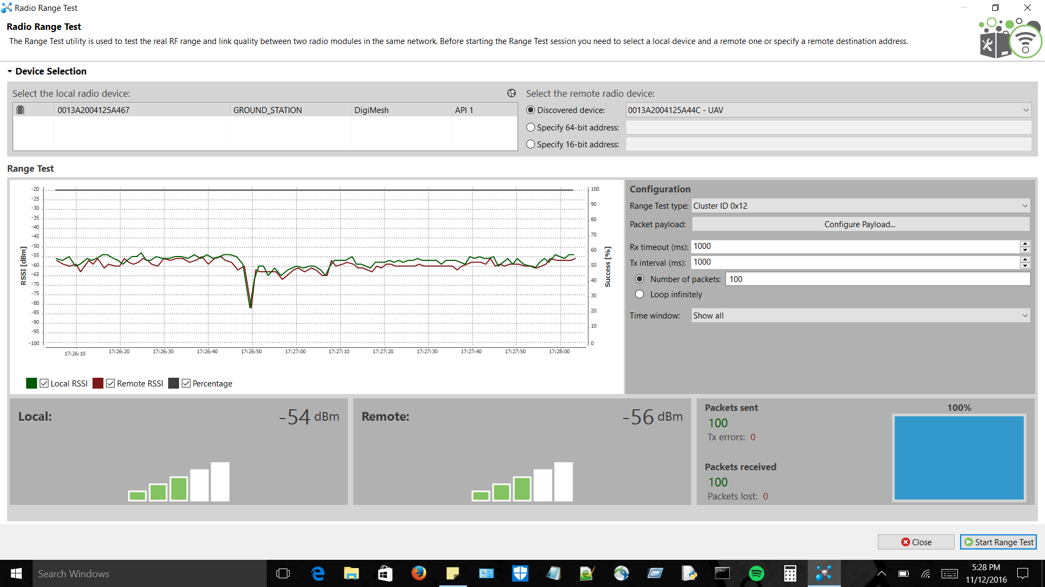
Transceiver Signal Test at 3800 ft.

Slide 20
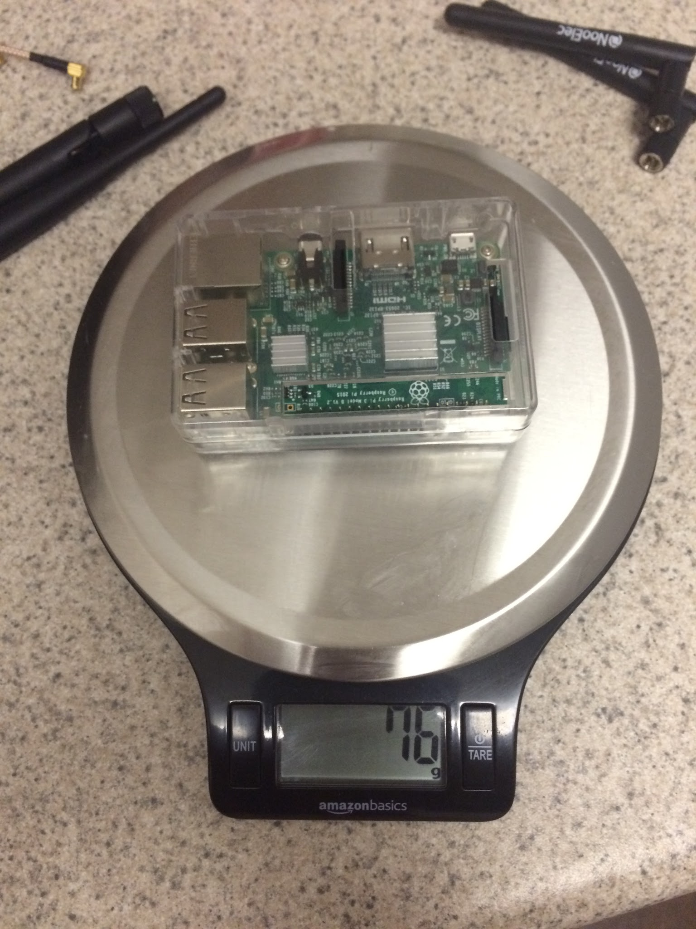
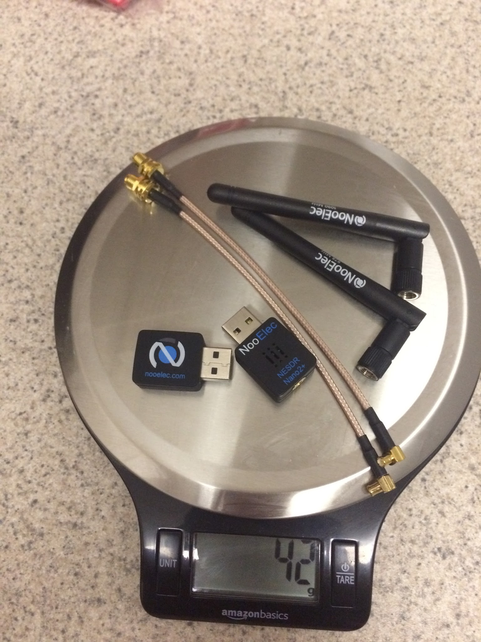
Device Weight
Component Name | Weight (grams)
Raspberry Pi 3 Model-B | 76
NooElec Nano 2 SDRs and accessories | 42
Xbee 900HP w/shield | 36
FlightPower FPRX 1600mAh | 68
UBEC DC-DC Converter | 15
Total Weight | 237

Slide 21
Power Supply Testing
The power supply designed to power the on-board system was tested to ensure operation for at least 1 hour.
Each component tested using in-line usb ammeter.
Current draw tested over 10 minute interval using digital multimeter and real-time sampling software.
Notes:
clayton

Slide 22
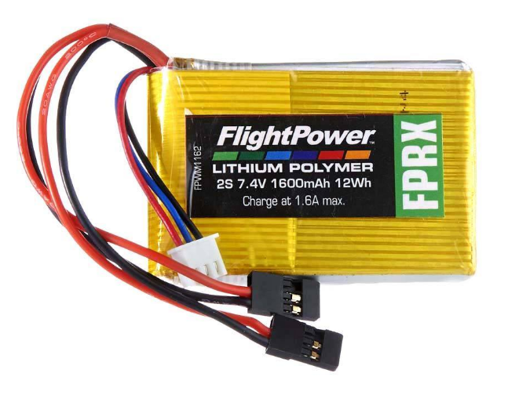
Battery
Flight Power FPRX
 | Output Voltage | 7.4V
 | Cell Configuration | 2S (2 cells in series)
 | Charge Rate | 1C (1*1.6A)
 | Discharge Rate | 1C (1*1.6A)
 | Capacity | 1600mAh (12Wh)
The Battery voltage was limited to the Raspberry Pi’s required operating range of 4.5V to 5.5V. The step down in voltage resulted in a reduction in current draw on the battery.

Slide 23
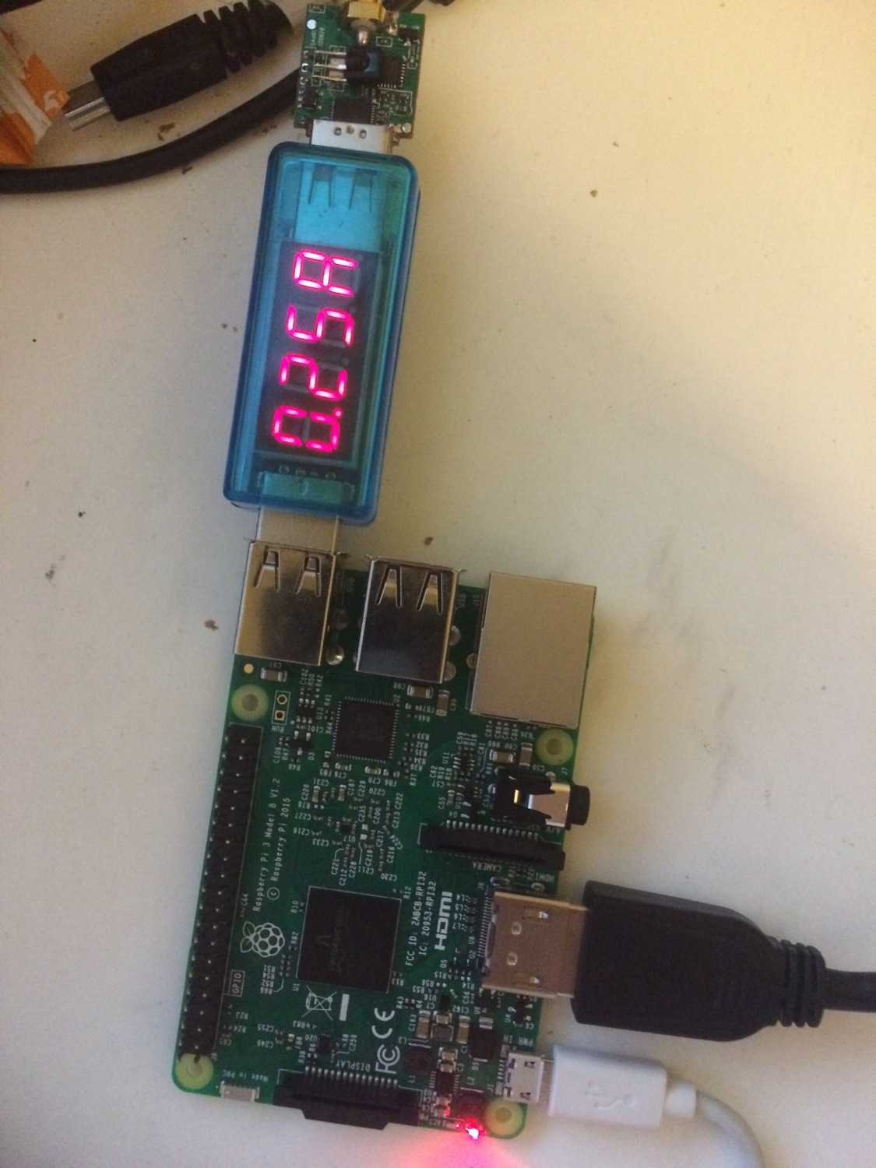
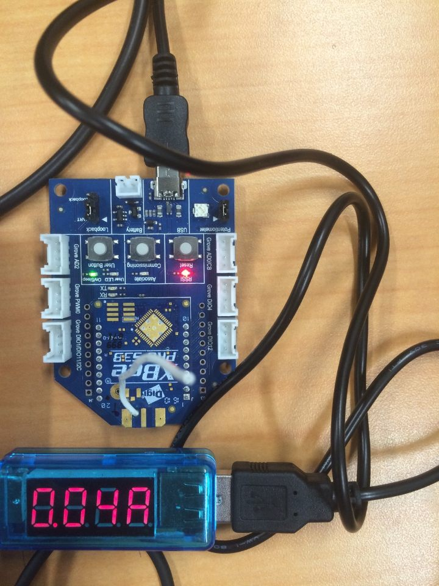
Current Draw of SDR(Left), Transceiver(Right)
The current draw of each device was tested with an in-line usb ammeter.

Slide 24
Current Draw Test (USB ammeter)
Current Draw Test Results
 | Current Draw | Voltage | Power Draw
SDR (x2) | 290 mA-hr each | 5 V | 2.9 W-hr
Raspberry Pi | 400 mA-hr | 5 V | 2 W-hr
Transceiver | 215 mA-hr | 2.1-3.6 V | 0.46-0.774 W-hr
Needed | 1.195 A-hr | 5 V | 5.975 W-hr

Slide 25
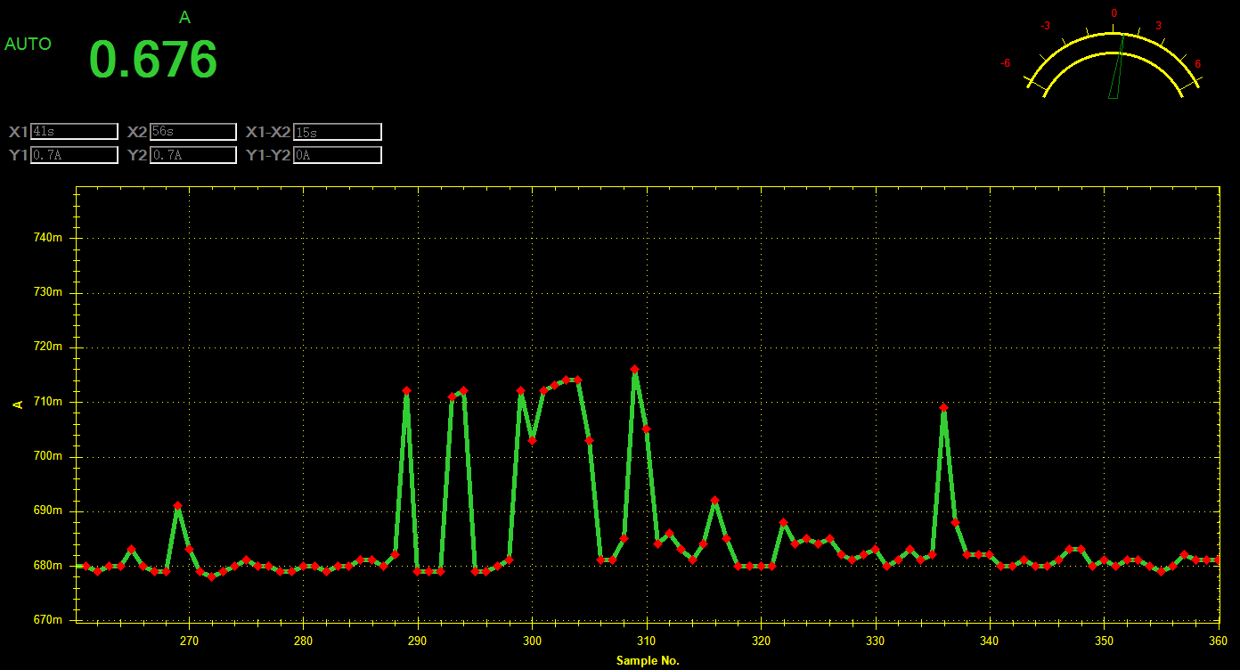
Battery Life Test
The current draw was tested over the course of ten minutes using a digital multimeter and real-time sampling software.
 | Current Range (mAh)
Operation w/out Signal | 674-685
Operation w/ Signal | 678-716
Maximum | 748
Minimum | 660

Slide 26
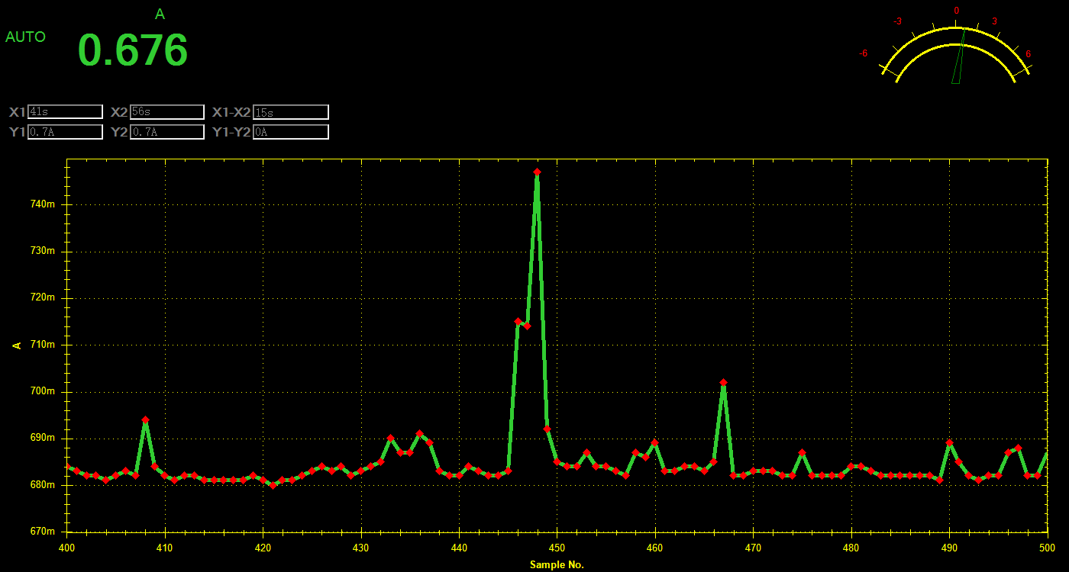
Battery Life Test
The current draw was tested over the course of ten minutes using a digital multimeter and real-time sampling software.
*Maximum Current Draw: 748mAh | Calculated (usb ammeter) | Measured (@ max.)
Current Draw (Ah) | 1.195 | 0.748*
Power Draw (Wh) | 5.975 | 5.532
Battery Current Capacity: 1.6Ah
Battery Power Capacity: 12Wh

Slide 27
Forwarding of Data
Testing initially done with TCP
Transceivers were tested and were able to easily able to transmit a heavy payload of ADS-B messages
Simulated data sent through for testing matched the data being received and decoded
Notes:
Brian starts here

Slide 28
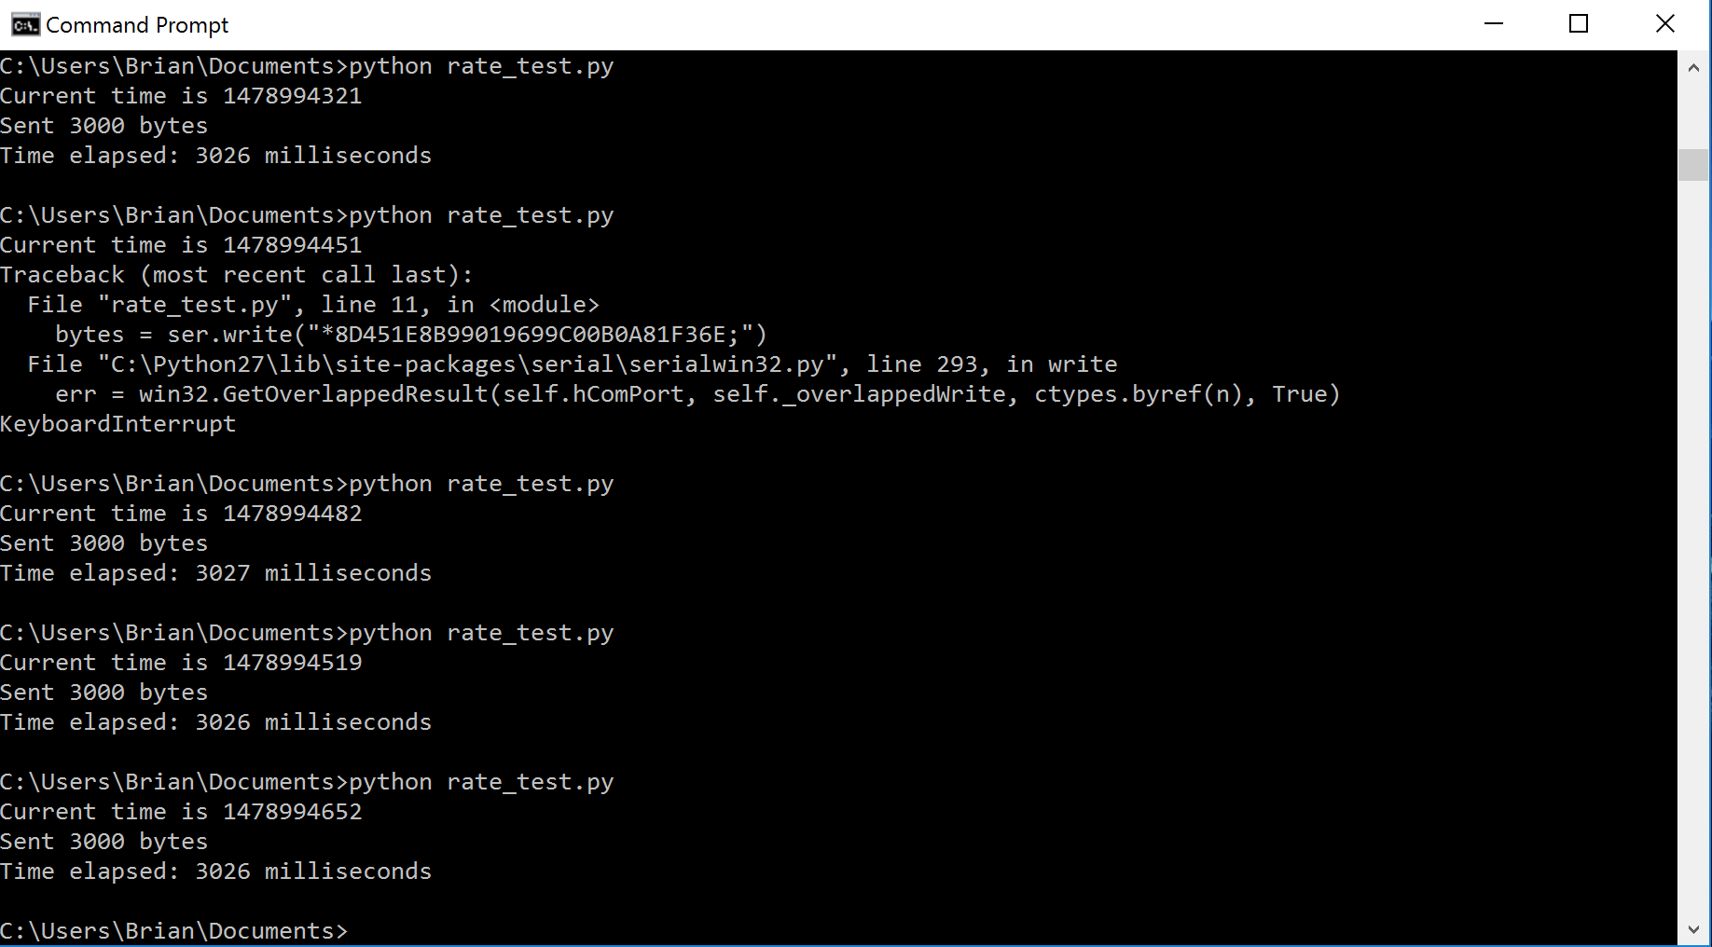
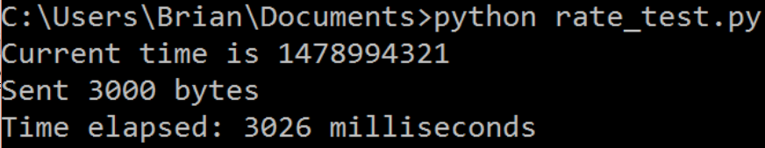
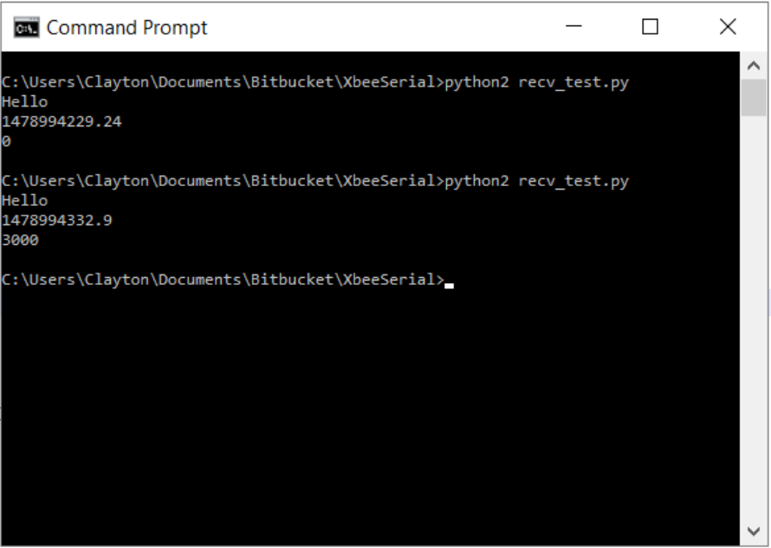
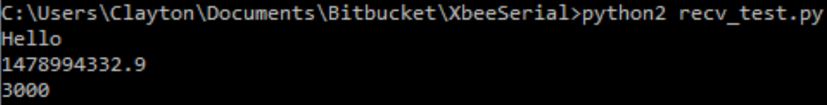
Data Rate Test at 3800ft. (3,000 bytes)

Slide 29
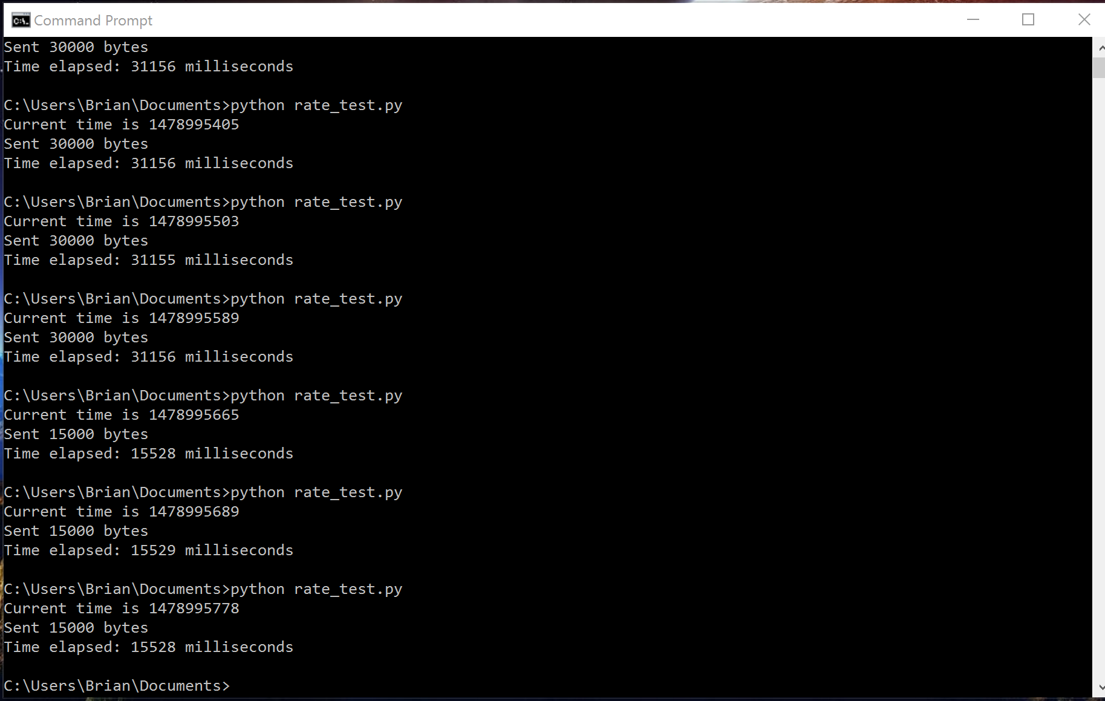
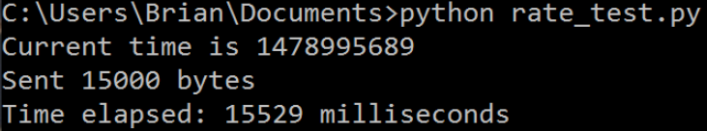
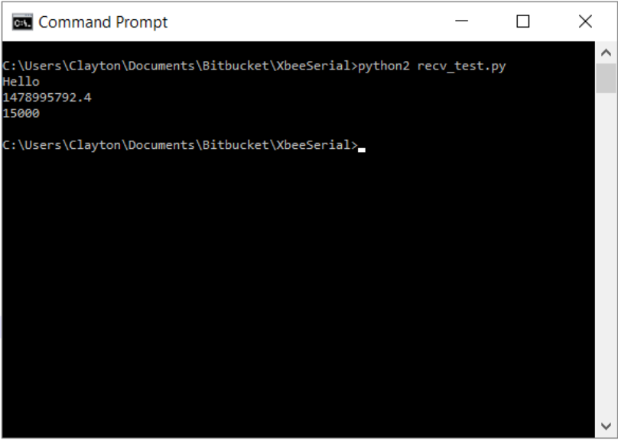
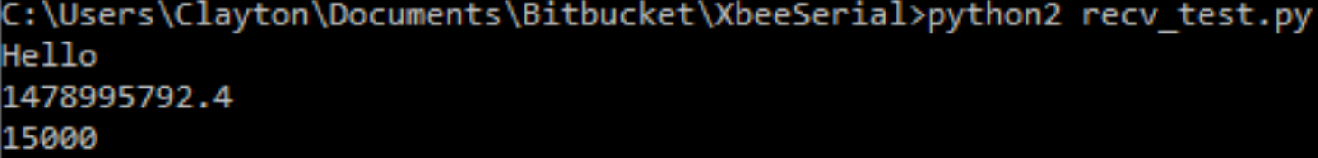
Data Rate Test at 3800ft. (15,000 bytes)

Slide 30
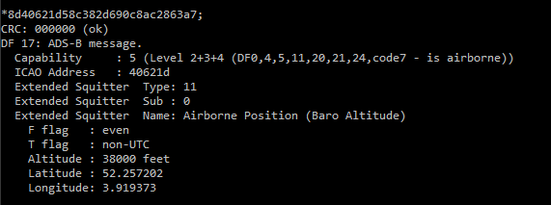
Data Reading out to Command Line

Slide 31
Timeline
 | August | September | October | November | December
Research
Prototyping and Software
Testing and Debugging
Final Design Changes

Slide 32
Progress
Able to receive signals on 1090 and 978, and send raw data packets through a TCP connection simulating the air-to-ground datalink. (From RPi to Laptop)
Able to receive ADS-B messages on 1090 and 978 and send it over the transceivers to the ground station for decoding.
Decoded messages printed to terminal.

Slide 33
Current Issues
Google API policies changed, changing to OpenLayers3.

Slide 34
Future Work
Multilateration
More compact design
Higher Xbee range using high-gain antennas
Display map

Slide 35
References
[1] "A320 collision heightens UAV safety concerns", Flightglobal.com, 2016. [Online]. Available: https://www.flightglobal.com/news/articles/a320-collision-heightens-uav-safety-concerns-424419/. [Accessed: 30- Aug- 2016].
[2] D. A. R. Reserved, "Phantom 3 standard," 2015. [Online]. Available: http://www.dji.com/phantom-3-standard/info#specs. Accessed: Nov. 10, 2016.
[3] "Realtek", Realtek.com.tw, 2016. [Online]. Available: http://www.realtek.com.tw/products/productsView.aspx?Langid=1&PFid=35&Level=4&Conn=3&ProdID=257. [Accessed: 06- Oct- 2016].

Slide 36
Questions?

